Slide 1



AI-DRIVEN JOB INTERVIEW ANALYZER
Short Title: Interview Den (S25-47-D)
Team: Hamza Saeed 21i-0671
Waleed Saeed 21i-1672
Asad Ullah Shah 21i-0545
Supervisor: Dr. Mehreen Alam

Slide 2
Project Focus
The AI-Driven Job Interview Analyzer aims to automate and optimize the hiring process by leveraging AI.
Our Goal
AI Resume Screening
AI Test Creation
AI Interview
AI based Scoring and Insights
Recap

Slide 3
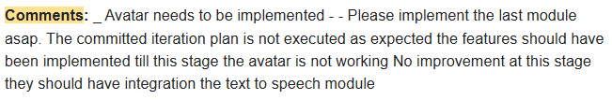
Feedback

Slide 4
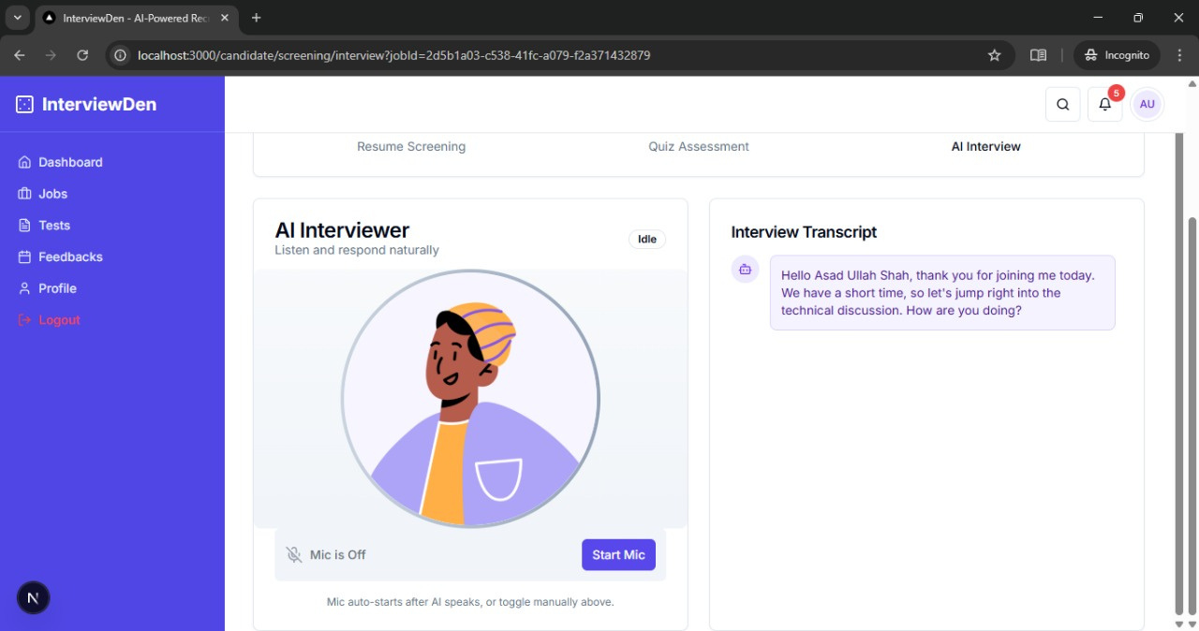

Slide 5
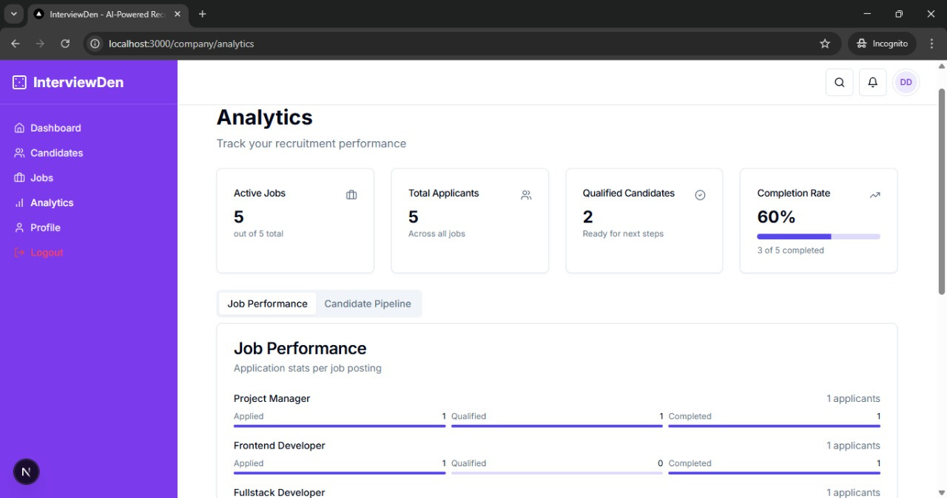

Slide 6
Iteration 2
APR-MAY
Develop company-side test creation portal:
- Multi-Agentic Model
- Multiple choice question system
- Question bank management
- Test difficulty settings
Implement test scoring system
Develop basic login/signup
Iteration 4
NOV - DEC
Integrate all components into a seamless workflow
Implement detailed reporting system:
- Candidate analytics
- Interview insights
- Skill assessment reports
Final testing and optimization
Documentation
Timeline
Iteration 1
JAN-MAR
Set up project infrastructure and basic architecture
Create company and candidate portals (Figma)
Implement core resume screening AI:
- Resume parsing system
- Basic job description matching
- Initial CV analysis algorithms
Unit testing, Poster making
Iteraton 3
SEP-OCT
Develop AI-powered interview system:
- Voice-based question handling
- Natural language processing for responses
- Technical assessment modules
Create comprehensive candidate evaluation system

Slide 7
AI Resume Screening
AI Test Creation
AI Interview
AI Scoring and Analytics
Modules

Slide 8
This Module
AI Scoring and Analytics
Final Scoring
Complete Dashboard
Real Time Feedback
Live Notifications
Testing
Text to Speech
Speech to text
Static Avatar
Finetuned Model on HuggingFace for Resume Screening (Module 1)

Slide 9
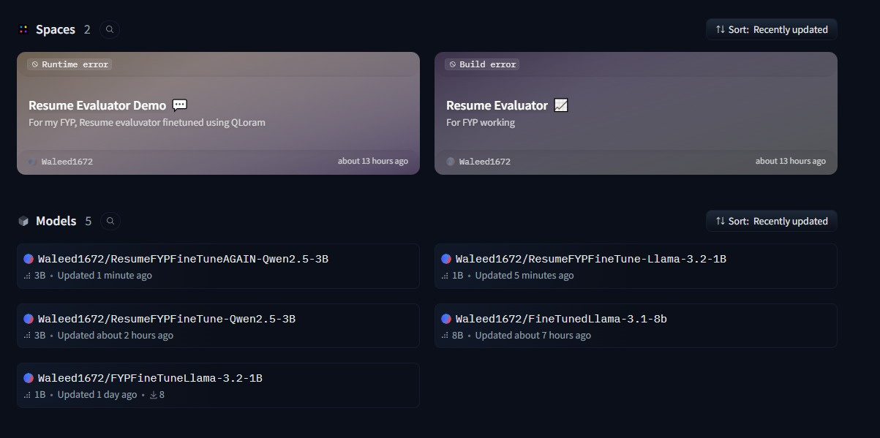
FineTuned Qwen2.5-3B and
Llama-3.2-1B for Resume Screening

Slide 10
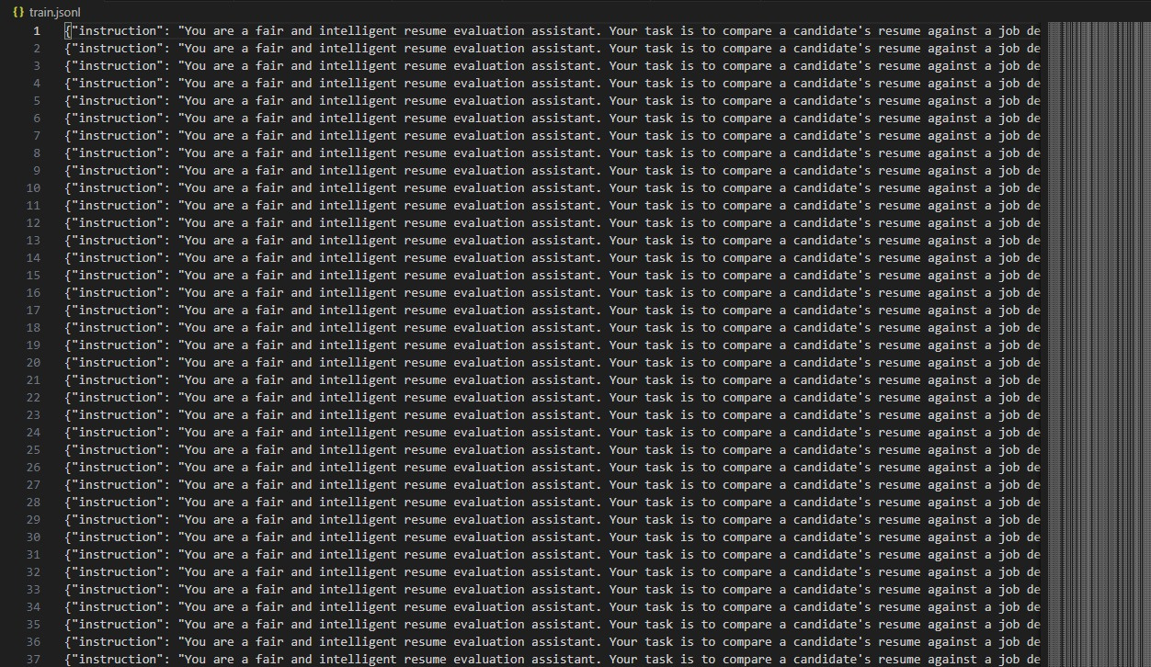

Slide 11
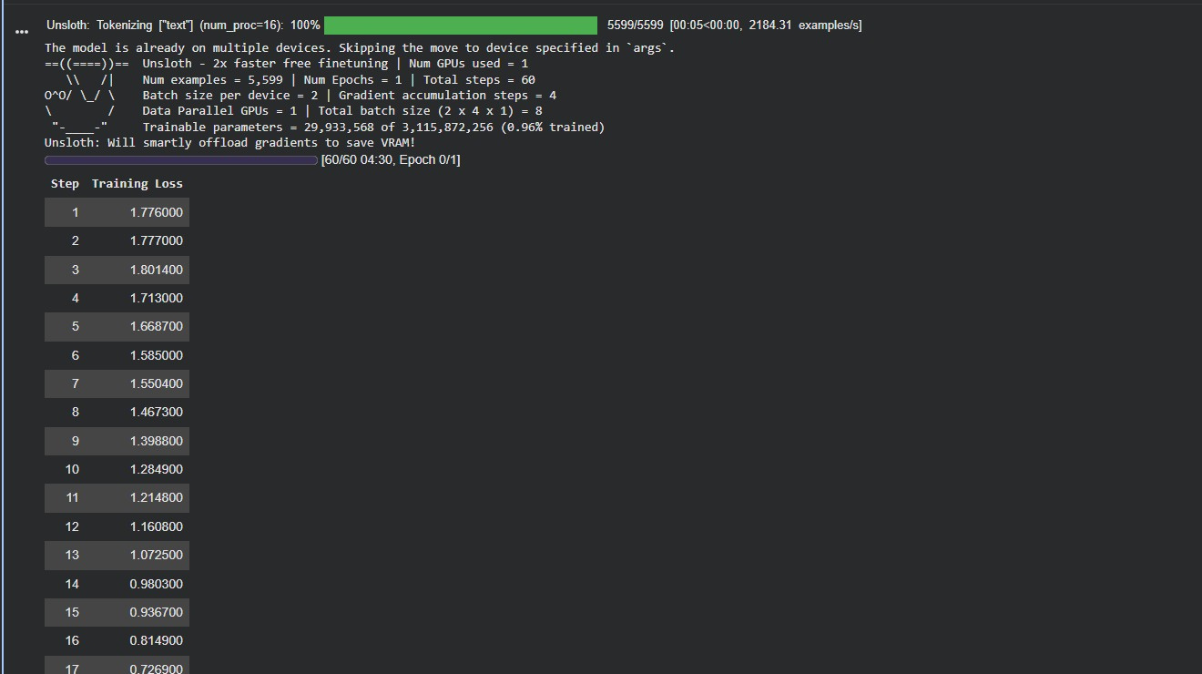

Slide 12
Done up to present time
AI Resume Screening
AI Test Creation
AI Interview
AI Scoring
Analytics Dashboard
Testing and Deployment

Slide 13
Thank you!
Any Questions?

Slide 14
Demo

